Slide 1
Technical Deep Dive: Creating Apps for the Intelligent Cloud – Serverless code, Integration and background jobs
Henrique Graça

Slide 2
Agenda
Background Jobs triggers & types
Azure Web Jobs
Azure Functions
Logic Apps
Azure Batch

Slide 3
Background Jobs

Slide 4




What are background Jobs?
Background tasks that run independently of the user interface (UI).
Jobs that can be executed without requiring user interaction.
Examples include batch jobs, intensive processing tasks, and long-running processes such as workflows.
Web App
Queue
SQL
Background Job
Notes:
Many types of applications require background tasks that run independently of the user interface (UI).
Examples include batch jobs, intensive processing tasks, and long-running processes such as workflows.
Background jobs can be executed without requiring user interaction--the application can start the job and then continue to process interactive requests from users.
This can help to minimize the load on the application UI, which can improve availability and reduce interactive response times.
For example a user placing an order can initiate a background workflow that processes the order, while the UI allows the user to continue browsing the web app. When the background job is complete, it can update the stored orders data and send an email to the user that confirms the order.

Slide 5
Types of background jobs
Background jobs typically include one or more of the following types of jobs:
CPU-intensive jobs
I/O-intensive jobs
Batch jobs
Long-running workflows
Notes:
CPU-intensive jobs, such as mathematical calculations or structural model analysis.
I/O-intensive jobs, such as executing a series of storage transactions or indexing files.
Batch jobs, such as nightly data updates or scheduled processing.
Long-running workflows, such as order fulfillment, or provisioning services and systems.

Slide 6
Triggers
Background jobs can be initiated in several different ways. They fall into one of the following categories:
Event-driven triggers. The task is started in response to an event, typically an action taken by a user or a step in a workflow.
Schedule-driven triggers. The task is invoked on a schedule based on a timer. This might be a recurring schedule or a one-off invocation that is specified for a later time.
Notes:
Event-driven triggers
Event-driven invocation uses a trigger to start the background task. Examples of using event-driven triggers include:
The UI or another job places a message in a queue. The message contains data about an action that has taken place, such as the user placing an order. The background task listens on this queue and detects the arrival of a new message. It reads the message and uses the data in it as the input to the background job.
The UI or another job saves or updates a value in storage. The background task monitors the storage and detects changes. It reads the data and uses it as the input to the background job.
The UI or another job makes a request to an endpoint, such as an HTTPS URI, or an API that is exposed as a web service. It passes the data that is required to complete the background task as part of the request. The endpoint or web service invokes the background task, which uses the data as its input.
Typical examples of tasks that are suited to event-driven invocation include image processing, workflows, sending information to remote services, sending email messages, and provisioning new users in multitenant applications.
Schedule-driven triggers
Schedule-driven invocation uses a timer to start the background task. Examples of using schedule-driven triggers include:
A timer that is running locally within the application or as part of the application’s operating system invokes a background task on a regular basis.
A timer that is running in a different application, or a timer service such as Azure Scheduler, sends a request to an API or web service on a regular basis. The API or web service invokes the background task.
A separate process or application starts a timer that causes the background task to be invoked once after a specified time delay, or at a specific time.
Typical examples of tasks that are suited to schedule-driven invocation include batch-processing routines (such as updating related-products lists for users based on their recent behavior), routine data processing tasks (such as updating indexes or generating accumulated results), data analysis for daily reports, data retention cleanup, and data consistency checks.

Slide 7
Azure Web Jobs

Slide 8
What is Azure WebJob
Host and schedule background jobs on an existing web app.
Can be triggered manually, scheduled to run on or at specific
time or run continuously.
Supported scripts or programs:
.cmd, .bat, .exe (using Windows cmd)
.ps1 (using PowerShell)
.sh (using Bash)
.php (using PHP)
.py (using Python)
.js (using Node.js)
.jar (using Java)
Can scale with your web application.
Notes:
Explain what are Webjob and how they are helpful. Talk about a simple example on how the background worker role or a job can be helpful.
Explain the different ways in which the web jobs can be triggered.
What are the different supported scripts which can be used as a web job.
How the web job can be scaled with your application. As web job runs within the App Service Plan, so when you scale up the service plan your web job will be scaled along with it.

Slide 9
WebJob SDK
Makes creating WebJobs easy
Blobs, Queues, Tables, Service Bus
Model Binding, also Extensible
Detailed execution history reports
SDK Extensions:
TimerTrigger
FileTrigger
SendGrid
ErrorTrigger
WebHooks

Slide 10
Deployment Options
Azure Portal
Visual Studio
VSTS – Build
FTP
Drag-n-Drop in KUDU
Others…
Notes:
Explain the different ways of deploying the web jobs.

Slide 11
Demo

Slide 12
Azure Functions

Slide 13
What is “serverless”
Abstraction of servers
Event-driven scale
Sub-second billing
Notes:
Abstraction of servers, infrastructure and configuration of operating system
Event-driven scale
Sub-second billing
Stateless
Serverless compute is a fully managed service. Some refer to it as Functions as a Service
OS and Framework patching is performed for you
There is zero administrative tasks and no need to manage any infrastructure
You just deploy your code (function) and it runs
Your code runs within seconds and for very short period of time
Serverless compute scales quickly (almost instantly) and vastly
Automatically scales within seconds
No scale configuration is required (there is no way to configure scale or limits)
Scales to match any given workload. Scales from zero to handle tens of thousands concurrent functions invocations within seconds
Pay only for the time your code is running
Serverless compute reacts to events
React, in near real-time, to events and triggers
Triggered by virtually any event from Azure service or 3rd party services

Slide 14
How is it different
Mono-lithic application
Inside client app
Complex framework
Loosely coupled components
Outside client app
Micro-functionality
Notes:
Mono-lithic application -> loosely coupled components
Events happening async outside client application
Build/use micro-functionality to react to a single event
VS WebJobs
Here are their similarities:
Both are built on Azure App Service and enjoy features such as source control, authentication, and monitoring.
Both are developer-focused services.
Both support standard scripting and programming languages.
Both have NuGet and NPM support.
+
Functions is the natural evolution of WebJobs in that it takes the best things about WebJobs and improves upon them. The improvements include:
Serverless app model.
Streamlined dev, test, and run of code, directly in the browser.
Built-in integration with more Azure services and 3rd-party services like GitHub WebHooks.
Pay-per-use, no need to pay for an App Service plan.
Automatic, dynamic scaling.
For existing customers of App Service, running on App Service plan still possible (to take advantage of under-utilized resources).
Integration with Logic Apps.

Slide 15
Benefits of “serverless”
Ship faster
Reduced dev ops
Focus on business logic
Notes:
“Pinnacle of PaaS compute”
Not just hardware “servers”, but software servers are also managed for you
Focus on business logic, not solving technical problems not core to business
Lower effort to get started makes it easier to experiment (bots, etc.)

Slide 16








Azure Functions
Serverless
Accelerate development
Bind into services
Azure Service Bus
Azure Event Hub
Azure Storage
</>
Dropbox
Sendgrid
AzureDocDb
Event-driven scale
Reduced Dev Ops
Develop your way
Local development
OneDrive
Box
Twilio

Slide 17


Functions
Code
Azure Functions
Events & Data
Develop locally using best of class developer tools
Boost productivity through triggers and bindings
Choose from a variety of programming languages
Integrate with existing DevOps processes
Notes:
Ability to build, test and debug your Functions code locally on your own machine before your code is even deployed to the cloud. This is a massive productivity benefit while building cloud applications and something Azure provides through rich integration with a world class developer tool like Visual Studio
Secondly, unique features like triggers and bindings that make it super easy to setup event-driven architectures and simplify communication with data sources
Thirdly, we support a number of programming languages. In the demo we saw an example with C#. But we also support Node.js, F#, Python and even bash so you can pick the language of your choice to write serverless functions with
Lastly, Functions support concepts such as Continuous deployment, which makes it super easy to integrate them into your existing DevOps pipelines.

Slide 18
Integrations
Type | Service | Trigger | Input | Output
Schedule | Azure Functions | ✔
HTTP (REST or webhook) | Azure Functions | ✔ |  | ✔*
Blob Storage | Azure Storage | ✔ | ✔ | ✔
Events | Azure Event Hubs | ✔ |  | ✔
Queues | Azure Storage | ✔ |  | ✔
Queues and topics | Azure Service Bus | ✔ |  | ✔
Tables | Azure Storage |  | ✔ | ✔
Tables | Azure Mobile Apps |  | ✔ | ✔
No-SQL DB | Azure DocumentDB |  | ✔ | ✔
Push Notifications | Azure Notification Hubs |  |  | ✔
Twilio SMS Text | Twilio |  |  | ✔
Notes:
(* - The HTTP output binding requires an HTTP trigger)

Slide 19




Demo Architecture
UFO
Functions
Storage queue
Functions
Table storage
js
C#

Slide 20


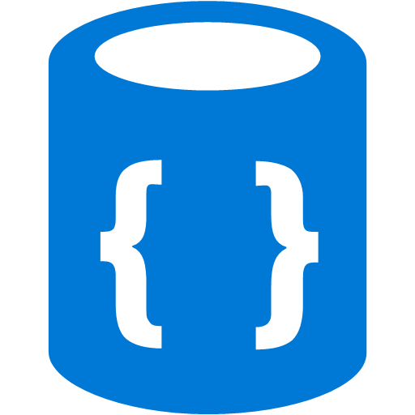



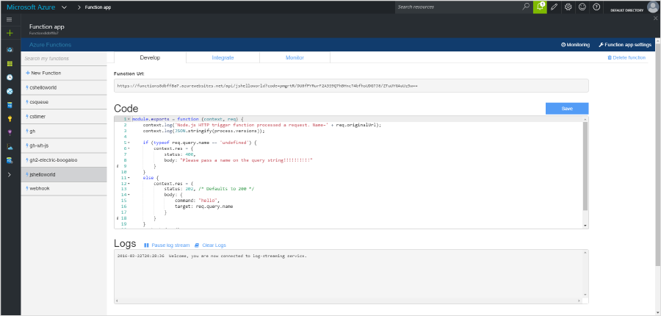
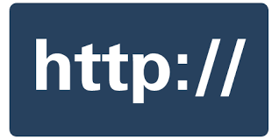



1) Trigger
2) Input Binding
3) Develop
4) Execute
5) Output Binding
Web
Hooks
App Services
Hosting Plans
Azure Services
Azure Services
Azure Services
7) Develop Locally
6) Monitor and Improve
Notes:
This is the whole (top level) Dev Ops story where Dev build wounderful apps, using CI they mange their code, builds, and releases. Connecting to a repository, they can deploy to Azure Websites, build in the cloud, deploy to a slot to test and validate, swap into production, deployed across the globe as needed, monitor and get feedback, on which devs can make updates. Rinse and repeat

Slide 21
Demo

Slide 22
Use Cases

Slide 23
Applications
Example: Timer based processing
Eve
r
y 15 minutes
Find and clean invalid data
Clean table

Slide 24
Applications
Example: Azure service event processing
CSV
File added to
T
ransfo
r
m CSV to data
r
ows
P
ower BI
Blob Storage
Cha
r
t graphic

Slide 25
Applications
Example: SaaS event processing
Excel file saved
Mic
r
os
o
f
t Graph API analyzes content
C
r
eates new sheets
to OneDrive
with cha
r
ts

Slide 26
Applications
Example: Serverless Web Applications architectures
Loaded web page
C
r
eate ad based on user p
r
o
file
Completed page
calls
W
ebHook

Slide 27
Async background processing
Example: Serverless Mobile back ends
Photo taken and
Sto
r
es in blob storage
P
r
oduces scaled images
W
ebHook called

Slide 28
Applications
Example: Real-time stream processing
Millions
o
f devices feed
T
ransfo
r
m to structu
r
ed data
Sto
r
e data in
into St
r
eam Analytics
SQL Online

Slide 29
Applications
Example: Real-time bot messaging
...
?
Message sent
Co
r
tana Analytics answe
r
s questions
Chatbot sends
to Chatbot
r
esponse

Slide 30
Platform & scaling

Slide 31
Platform and scaling
App Service offers dedicated and dynamic tiers.
Dedicated is the existing App Service plan tiers
Basic, Standard, Premium
Pay based on # of reserved VMs
You’re responsible for scale
Dynamic
Pay on number of executions
Platform responsible for scale

Slide 32
Dynamic tier pricing
Pay per execution model - two meters, three units
Number of executions
Duration of execution x reserved memory
Consumption plan pricing includes a monthly free grant of 1 million requests and 400,000 GB-s of resource consumption per month.

Slide 33

Consumption Pricing example
A function with observed memory consumption of 512 MB executes 3,000,000 times during the month and has an execution duration of one second. Monthly billing would be calculated as follows:
Total billing = Resource Consumption + Executions calculation
Resource Consumption
Resource consumption (seconds) = 3M * 1 sec = 3M sec
Resource consumption (GB-s) = (512 MB / 1,024 MB) * 3M = 1.5M GB-s
Billable resource consumption = 1.5M GB-s - 400,000 GB-s = 1.1M GB-s
Resource consumption cost = 1.1M GB-s * $0.000016/GB-s = $17.60
Executions calculation
Billable executions = 3M – 1M = 2M
Monthly executions cost = 2M * $0.20 = $0.40
Total
Total monthly cost = $17.60 + $0.40 = $18
Notes:
Resource consumption (GB-s) = converting MB to Gigbytes

Slide 34
Tips for improving the performance and reliability of Azure Functions
Avoid large long running functions
Cross function communication.
Write functions to be stateless
Write defensive functions.
Don't mix test and production code in the same function app.
Use async code but avoid Task.Result
Notes:
https://docs.microsoft.com/en-us/azure/azure-functions/functions-best-practices
Avoid long running functions
Large, long-running functions can cause unexpected timeout issues. A function can become large due to many Node.js dependencies. Importing dependencies can also cause increased load times that result in unexpected timeouts. Dependencies are loaded both explicitly and implicitly. A single module loaded by your code may load its own additional modules.
Whenever possible, refactor large functions into smaller function sets that work together and return responses fast. For example, a webhook or HTTP trigger function might require an acknowledgment response within a certain time limit; it is common for webhooks to require an immediate response. You can pass the HTTP trigger payload into a queue to be processed by a queue trigger function. This approach allows you to defer the actual work and return an immediate response.
Cross function communication
When integrating multiple functions, it is generally a best practice to use storage queues for cross function communication. The main reason is storage queues are cheaper and much easier to provision.
Individual messages in a storage queue are limited in size to 64 KB. If you need to pass larger messages between functions, an Azure Service Bus queue could be used to support message sizes up to 256 KB.
Service Bus topics are useful if you require message filtering before processing.
Event hubs are useful to support high volume communications.
Write functions to be stateless
Functions should be stateless and idempotent if possible. Associate any required state information with your data. For example, an order being processed would likely have an associated state member. A function could process an order based on that state while the function itself remains stateless.
Idempotent functions are especially recommended with timer triggers. For example, if you have something that absolutely must run once a day, write it so it can run any time during the day with the same results. The function can exit when there is no work for a particular day. Also if a previous run failed to complete, the next run should pick up where it left off.
Write defensive functions
Assume your function could encounter an exception at any time. Design your functions with the ability to continue from a previous fail point during the next execution. Consider a scenario that requires the following actions:
Query for 10,000 rows in a db.
Create a queue message for each of those rows to process further down the line.
Depending on how complex your system is, you may have: involved downstream services behaving badly, networking outages, or quota limits reached, etc. All of these can affect your function at any time. You need to design your functions to be prepared for it.
How does your code react if a failure occurs after inserting 5,000 of those items into a queue for processing? Track items in a set that you’ve completed. Otherwise, you might insert them again next time. This can have a serious impact on your work flow.
If a queue item was already processed, allow your function to be a no-op.
Take advantage of defensive measures already provided for components you use in the Azure Functions platform. For example, see Handling poison queue messages in the documentation for Azure Storage Queue triggers.
Don't mix test and production code in the same function app
Functions within a function app share resources. For example, memory is shared. If you're using a function app in production, don't add test-related functions and resources to it. It can cause unexpected overhead during production code execution.
Be careful what you load in your production function apps. Memory is averaged across each function in the app.
If you have a shared assembly referenced in multiple .Net functions, put it in a common shared folder. Reference the assembly with a statement similar to the following example:
Copy
#r "..\Shared\MyAssembly.dll". Otherwise, it is easy to accidentally deploy multiple test versions of the same binary that behave differently between functions.
Don't use verbose logging in production code. It has a negative performance impact.
Use async code but avoid blocking calls
Asynchronous programming is a recommended best practice. However, always avoid referencing the Resultproperty or calling Wait method on a Task instance. This approach can lead to thread exhaustion.

Slide 35
Logic Apps

Slide 36
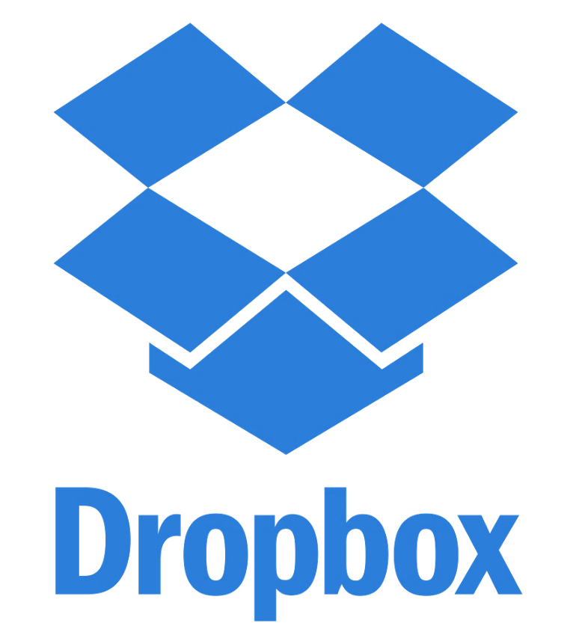



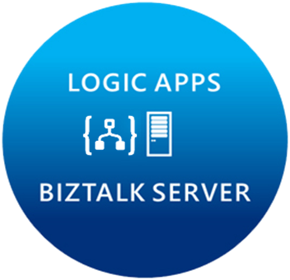
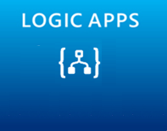

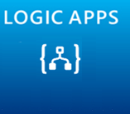




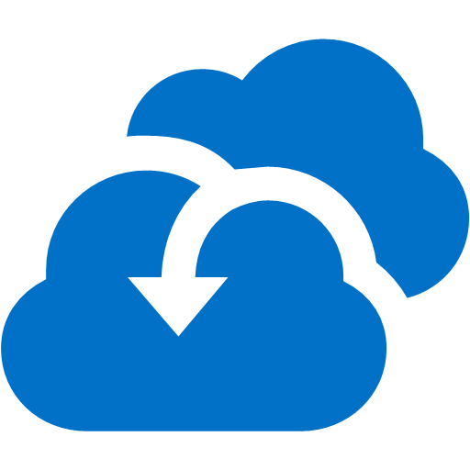

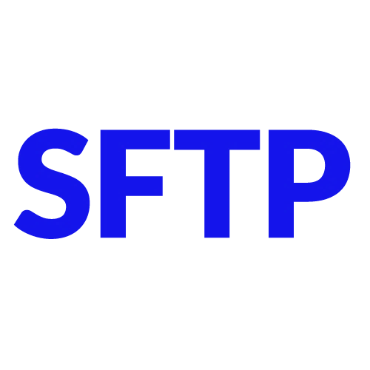



Microsoft’s Cloud Integration Platform
LOGIC APPS
BIZTALK SERVER
About 39% of developers are focused on building cloud based Application integration
API MANAGEMENT
AZURE SERVICE BUS
IoT/Event Hub
Azure Search
SQL Database
CONNECTORS
AZURE SERVICES
AZURE SERVICE BUS
DocDB
BLOB Storage
Functions
API MANAGMENT
Machine Learning
HD Insight
Site Recovery
B2B/EDI
Tables
Cognitive Services
DNS
Notes:
Its not just about the products, we have a pool of out-of-the-box connectors that help connect to many SaaS applications.
Secret sauce is really the Azure services.
Azure is now at your fingertips – opens doors to numerous possibilities.
Traditional integration vendors, ask customers to build silo-ed integration solutions.
That approach is not going to allow you to scale to your customer needs.
With Azure, you can build holistic solutions.
I can do more than integration – once you have your connected system, you can perform analytics on the data using HD insight, machine learning, to gain insight on your data.
This is going to help customers make great business decisions.
Some of you have IoT practices today, this is how you can leverage integration and IoT together.
At MSFT, we think that there are multiple points of entry into integration: Think about your customers who reach out to you about mobile development, about IoT solutions, any e-commerce applications, eventually they are going to need a solid integration platform – and that’s what MSFT offers.
2 key differentiating factors to highlight again:
Hybrid 2. Azure Services

Slide 37
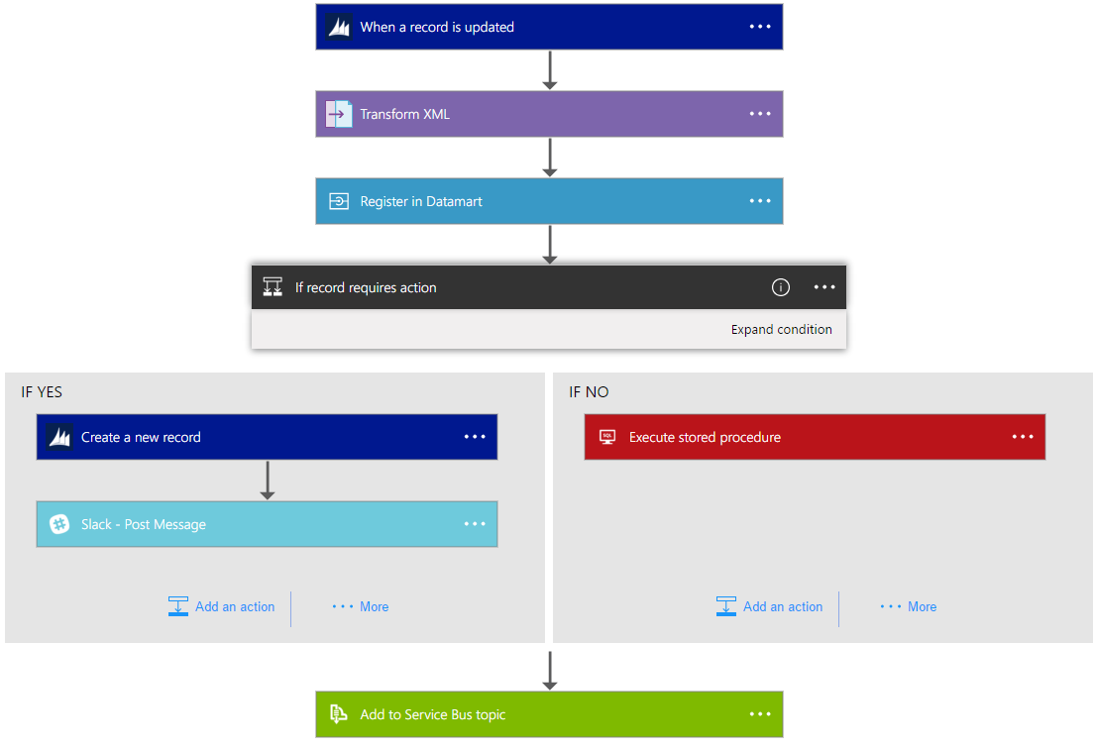
Introducing Azure Logic Apps
Powerful Integration. Hyperscale Workflow Engine, born in Azure
Faster integration using innovative Visual Designer
Easy workflow creation with triggers and actions
Mashup applications, data and services
Built for mission critical Enterprise Integration
Create, deploy, manage and monitor
Notes:
Read Slide

Slide 38
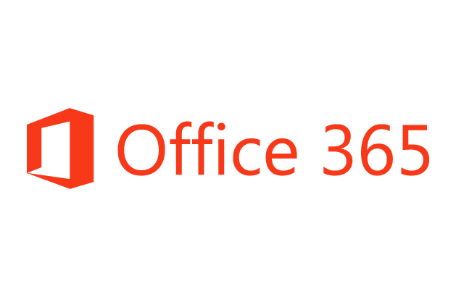










Logic Apps connects everything
Hybrid
Secure Gateway
As easy as connecting to cloud services
Better Together
Rich Azure Services
API Management
Azure Functions
Complete
PaaS Support
B2B Capabilities
SaaS Connectors
Machine Learning
B2B & EDI
Service Bus
Logic Apps
Cognitive Services
API Management
On-premises data gateway
BizTalk Server
Notes:
Logic Apps can integrate with “anything” (APIs) and solve small or complex problems. Automation in a secure and reliable environment fast and easy.
Connect Anything:
On-premises, hybrid and cloud
Mission critical, complex integration scenarios
Business productivity
Agile Business:
Quickly create workflows
Position to the future API centric
Transform Business:
Extract value from both (on-premises and cloud apps)
Build Holistic integration solutions.

Slide 39
SaaS
10to8
Act!
appFigures
Asana
Azure Active Directory
Azure API Management
Azure App Services
Azure Automation
Azure Cognitive Face API
Azure Cognitive LUIS
Azure Cognitive Text Analytics
Azure Cognitive Vision
Azure Data Lake Store
Azure Document DB
Azure Event Hubs
Azure Functions
Azure Machine Learning
Azure Resource Manager
Azure Service Bus
Azure SQL
Azure Storage Blob
Azure Storage Queues
Basecamp2&3
Benchmark Email
Bing Search
BitBucket
Bitly
Blogger
Box
Buffer
Campfire
CapsuleCRM
Chatter
Common Data Service
Disqus
DocuSign
Dropbox
Dynamics AX Online
Dynamics CRM Online
Dynamics CRM Service Bus
Dynamics Financials
Dynamics Operations
Easy Redmine
Eventbrite
Facebook
FreshBooks
Freshdesk
GitHub
Gmail
Google Calendar
Google Contacts
Google Drive
Google Sheets
Google Tasks
GoTo Meeting
GoTo Training
GoTo Webinar
Harvest
HelloSign
HipChat
Infusionsoft
Inoreader
Insightly
Instagram
Instapaper
Intercom
JIRA
LeanKit
LiveChat
MailChimp
Mandrill
Microsoft Translator
Medium
MSN Weather
Muhimbi PDF
Nexmo
Office 365
Office 365 Users
Office 365 Video
OneDrive
OneDrive for Business
OneNote
Outlook.com
Outlook Customer Manager
Outlook Tasks
Paylocity
PagerDuty
Pinterest
Pipedrive
Pivotal Tracker
Power BI
Project Online
Redmine
Salesforce
Salesforce Chatter
SendGrid
SharePoint Online
Slack
SmartSheet
SparkPost
Stripe
Survey Monkey
Teradata
Todoist
Toodledo
Trello
Twilio
Twitter
Typeform
UserVoice
Vimeo
VS Team Services
Webmerge
Wordpress
Wunderlist
Yammer
YouTube
Zendesk
Logic Apps
XML & EDI
Cloud APIs and platform functionality
Over 130 built-in connectors
Hosted and managed within the platform
Scales to meet your needs
First class designer experience
Rapid development
XML Validation
Transform XML (+Mapper)
Flat File Encode
Flat File Decode
X12
EDIFACT
AS2
Int Account Artifact Lookup
Protocols/Native
HTTP, HTTPS
HTTP Webhook
FTP, SFTP
SMTP
RSS
Compose, Parse JSON
Query, Join, Table, Select
Schedule, Wait
Terminate
Workflow
API connections
Authenticate once and reuse
Differentiate connection configuration
Simple to deploy
Portal experience for managing API Connections
Hybrid
BizTalk Server
File System
IBM DB2
Informix
Oracle DB
SharePoint Server
SQL Server
SAP
Websphere MQ
Notes:
Call out that we now support stored procs on-prem

Slide 40
Demo

Slide 41
Concepts
Retry
Response
Split On
Action
Scope
Trigger
Retry
Conditional
Trigger
Iteration
Default 4 retries, 20 secs in between each
Configurable up to 1 hour in between
Can be disabled
Send Response to:
Manual Trigger
WebHook
Debatch incoming array
Run x instances of the logic app
Retrieve status for each
Call out:
API Apps (swagger)
HTTP endpoints
Other Logic Apps
Async Support: 202, retry after interval, …
Wait for Event:
Timespan
Webhook being called
Retry Policies (can be custom)
Encapsulate set of actions
Used for error handling and compensation
Possible to access result of each encapsulated action
If…Else boolean expression
Can have nested conditions
Recurring Schedule
Polling (wait on HTTP 202)
Webhooks
Manual: POST to workflow url
Subscribed: workflow subscribes itself
On Demand: ‘run now’
List Iteration
Loop single action over list of items
Runs the action x times
Possible to get statuses for each action
Do…Until
Loop single action based on condition
Runs action until evaluated to true
Define limit based on
Time
Number of iterations
Overall action has status/outputs but not for each iteration
Action
Scope
Response
Conditional
Split On
Iteration
Notes:
Triggers
A trigger starts a new instance of a workflow based on a specific event, like the arrival of an e-mail or a change in your Azure Storage account.
Actions
Each step after the trigger in a workflow is called an action. Each action typically maps to an operation on your managed connector or custom API apps.
SplitOn and debatching
Sometimes a trigger may receive an array of items that you want to debatch and start a workflow per item. This can be accomplished via the spliton command. By default, if your trigger swagger specifies a payload that is an array, a spliton will be added and start a run per item. SplitOn can only be added to a trigger. This can be manually configured or overridden in definition code-view. Currently SplitOn can debatch arrays up to 5,000 items. You cannot have a spliton and also implement the synchronous response pattern. Any workflow called that has a response action in addition to spliton will run asynchronously and send an immediate 202 Accepted response.
Retry policies
A retry policy is the most basic type of exception and error handling. If an initial request timed out or failed (any request that results in a 429 or 5xx response), this policy defines whether the action should retry. By default, all actions retry 4 additional times over 20-second intervals. So if the first request receives a 500 Internal Server Error response, the workflow engine pauses for 20 seconds, and attempts the request again. If after all retries, the response is still an exception or failure, the workflow continues and marks the action status as Failed.
Scopes
It is possible to group a series of actions together using a scope. This is particularly useful for implementing exception handling. In the designer you can add a new scope, and begin adding any actions inside of it.
Conditions: Run steps only after meeting a condition
To have your logic app run steps only when data meets specific criteria, you can add a condition that compares data in the workflow against specific fields or values.
For example, suppose you have a logic app that sends you too many emails for posts on a website's RSS feed. You can add a condition so that your logic app sends email only when the new post belongs to a specific category.
ForEach loop and arrays
Logic Apps allows you to loop over a set of data and perform an action for each item. This is possible via the foreach action. In the designer, you can specify to add a for each loop. After selecting the array you wish to iterate over, you can begin adding actions.
Until loop
You can perform an action or series of actions until a condition is met. The most common scenario for this is calling an endpoint until you get the response you are looking for. In the designer, you can specify to add an until loop. After adding actions inside the loop, you can set the exit condition, as well as the loop limits. There is a 1 minute delay between loop cycles.

Slide 42
Integration Account
XML Schemas and XSLT Maps
Trading Partners
Agreements
Certificates
Extensible
Store your own configuration
Easy to manage
REST API, PowerShell, Portal, Visual Studio
Secure & scalable
DR
Establish cross-region B2B DR under your control
Currently AS2 in preview with X12/EDIFACT
Schemas
Maps
TPM
Custom
Config
Notes:
For business-to-business (B2B) workflows and seamless communication with Azure Logic Apps, you can enable enterprise integration scenarios with Microsoft's cloud-based solution, the Enterprise Integration Pack. Organizations can exchange messages electronically, even if they use different protocols and formats. The pack transforms different formats into a format that organizations' systems can interpret and process. Organizations can exchange messages through industry-standard protocols, including AS2, X12, and EDIFACT. You can also secure messages with both encryption and digital signatures.
If you are familiar with BizTalk Server or Microsoft Azure BizTalk Services, the Enterprise Integration features are easy to use because most concepts are similar. One major difference is that Enterprise Integration uses integration accounts to simplify the storage and management of artifacts used in B2B communications.
Architecturally, the Enterprise Integration Pack is based on "integration accounts". These accounts are cloud-based containers that store all your artifacts, like schemas, partners, certificates, maps, and agreements. You can use these artifacts to design, deploy, and maintain your B2B apps and also to build B2B workflows for logic apps. But before you can use these artifacts, you must first link your integration account to your logic app. After that, your logic app can access your integration account's artifacts.

Slide 43
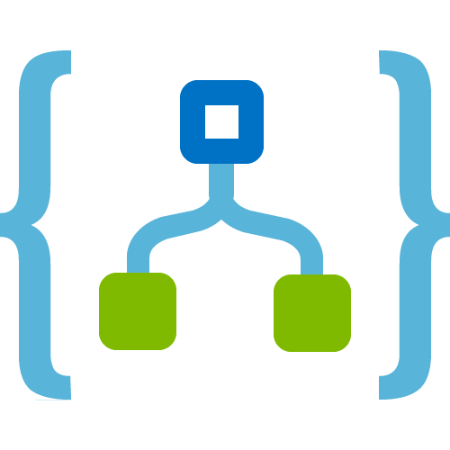










Easy Hybrid Integration
On-premises Data Gateway
Azure API
Management
Azure Service Bus
Logic Apps
Logic Apps
Logic Apps
On-premises data gateway for rich data and application integration
Azure API Management for SOAP and backend APIs
Service Bus for cross platform support
GatewayCloud Service
APIM
Azure Service Bus relay
Virtual network or public
Queues
Topics
Gateway
Data Sources
LOB
Systems
SOAP web services
Backend
APIs
API-based

Slide 44
Call to action
Build some Logic Apps!
Logic Apps Documentation: http://aka.ms/logicapps-docs
Logic Apps Blog: http://aka.ms/logicappsblog
Logic Apps Monthly Webcast: http://aka.ms/logicappslive
Microsoft Integration on Channel 9: https://channel9.msdn.com/Blogs/Microsoft-Integration
Logic Apps Ideas: http://aka.ms/logicapps-wish
Re-visit Build session recordings on Channel 9.
Continue your education at Microsoft Virtual Academy online.

Slide 45
Azure Batch

Slide 46
What is Azure Batch?
Azure Batch let you run large-scale parallel and high-performance computing applications efficiently in the cloud.
Scale to tens, hundreds or thousands of virtual machines
Cloud-enable batch and HPC applications
Stage data and execute compute pipeline
Choose Linux or Windows to run jobs
Autoscale on work in the queue
Pay for what you use with no capital investment
Notes:
Azure Batch is a platform service for running large-scale parallel and high-performance computing (HPC) applications efficiently in the cloud. Azure Batch schedules compute-intensive work to run on a managed collection of virtual machines, and can automatically scale compute resources to meet the needs of your jobs.
With Azure Batch, you can easily define Azure compute resources to execute your applications in parallel, and at scale. There's no need to manually create, configure, and manage an HPC cluster, individual virtual machines, virtual networks, or a complex job and task scheduling infrastructure. Azure Batch automates or simplifies these tasks for you.
Azure Batch is a free service; you aren't charged for the Batch account itself. You are charged for the underlying Azure compute resources that your Batch solutions consume
Explain about the batch service. Explain above points and add more details:
Choose your operating system and tools.
Cloud-enable your cluster applications
Imagine running at 100x scale
What to Execute?
Let Batch take care of scale for you
Deliver solutions as a service
Render animations quickly
Read more here about the above points: https://azure.microsoft.com/en-in/services/batch/

Slide 47
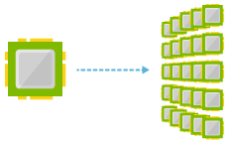
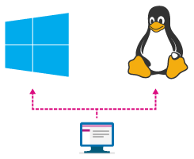
Batch Service
Cloud-scale job scheduling and compute management scaling to thousands of virtual machines for cloud-enabled batch and HPC applications
Stage data and execute compute pipelines
Choose Linux, Linux with Docker, or Windows
Notes:
A virtual machine is -- well -- a virtualized machine created and managed by a hypervisor such as VirtualBox or Hyper-V. Even though a VM runs on a machine that has an operating system, each VM requires its own complete operating system, even if it's the same operating system as the host OS. VMs offer a very high degree of isolation, but at a cost: longer startup times, lower portability (ever tried to move a 127 GB virtual hard disk, or VHD, from one PC to another?), and higher memory requirements. Containers, by contrast, leverage the operating system that is already in place but offer nearly as much separation. RAM requirements are lower since the OS isn't being duplicated in each container, and cost is lower, too, because while cloud platforms typically charge for each VM, a single VM can host multiple container instances.

Slide 48
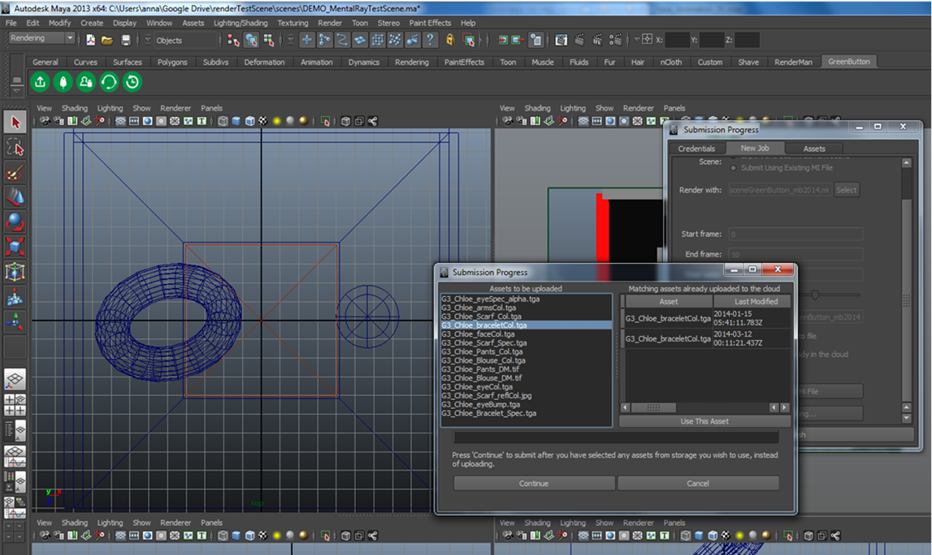
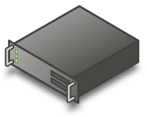
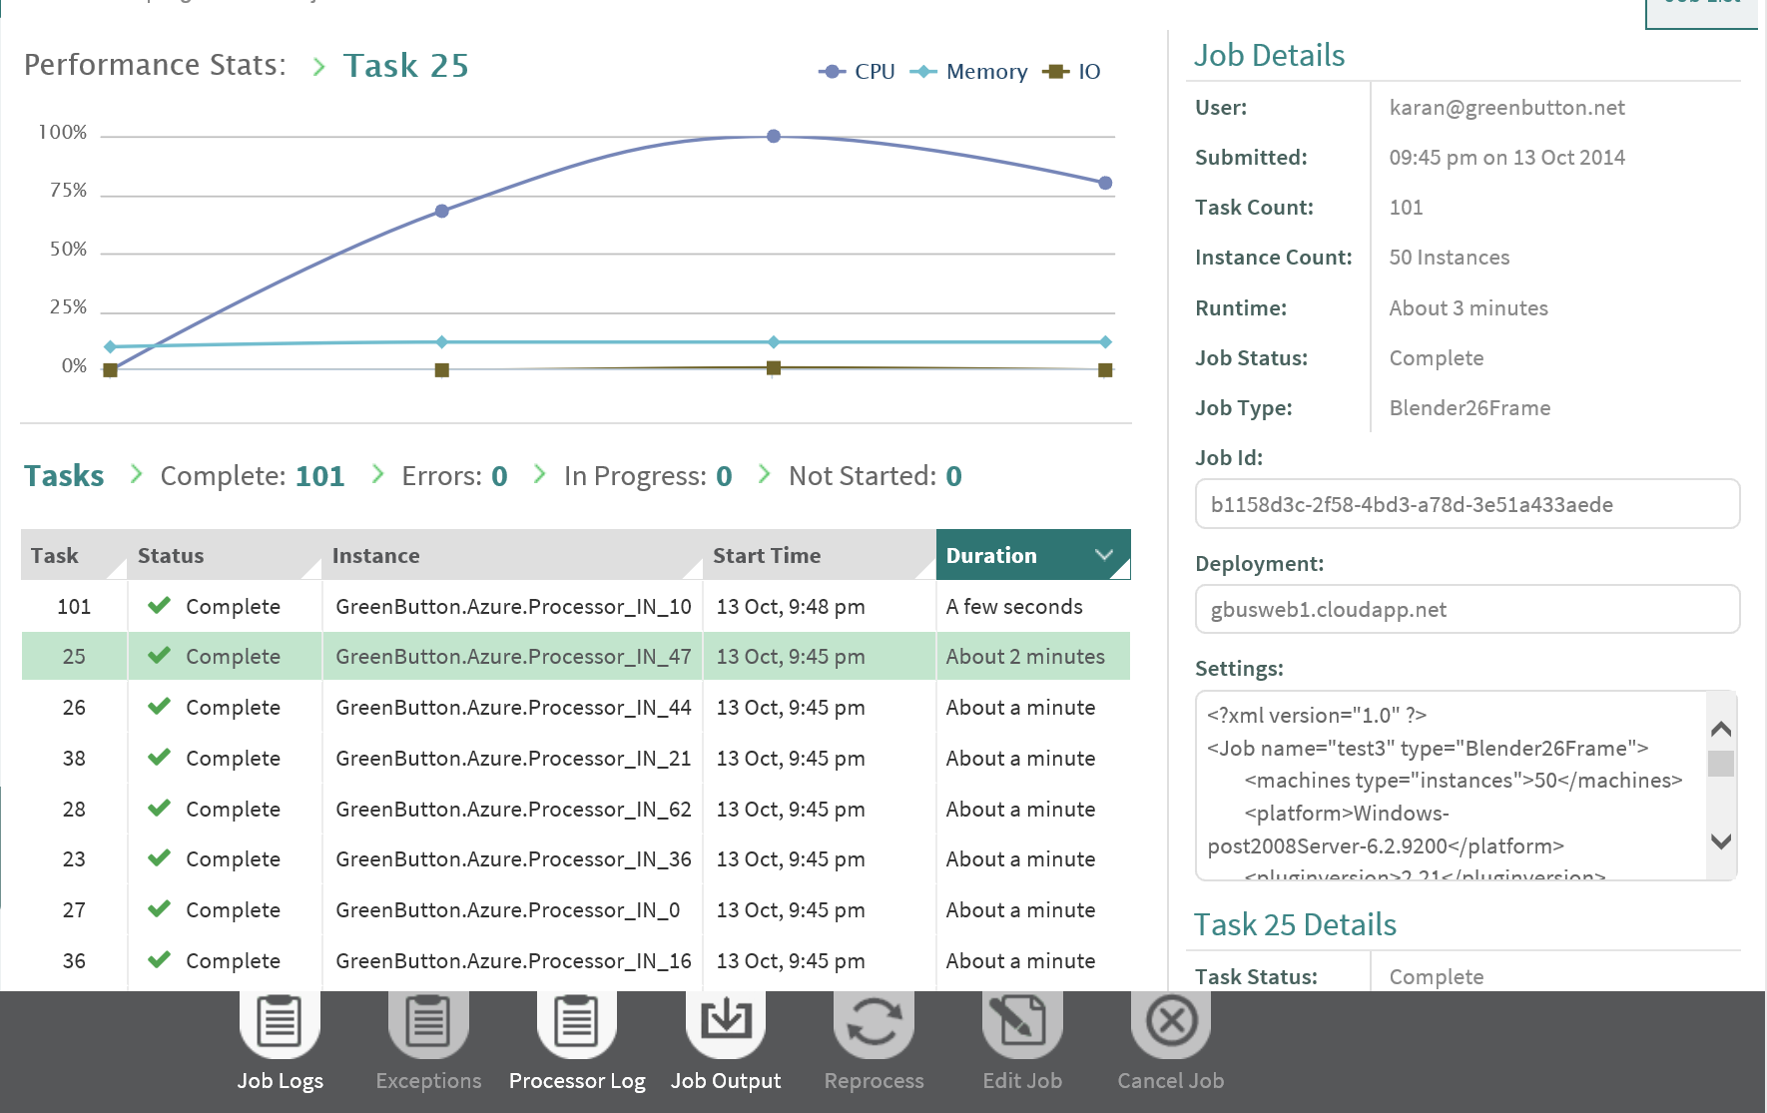
Overview
End-User
Submit jobs via plug-in
Sync data
Monitor via plug-in and/or portal
Developer
Client
Plug-in
Azure Batch
Application and Files
Ops / Admin
Job Splitter
Task Processor
Azure Storage
User & group mgmt.
Permissions
Job & VM monitoring
Usage reporting
Quota mgmt.
Troubleshooting
Use Batch SDK to cloud-enable & upload the app
Notes:
Explain the overview of the Azure Batch as shown in the diagram above. Explain the Developer, End-User and Ops/Admin part.
Developer can use of the SDK to make use of the Batch service. Azure Batch Service and Storage is in the cloud and with the help of the SDK you can submit the jobs.
Explain the points under End-User and Ops/Amin.
Azure Batch is a service that enables you to run batch processes on high-performance computing (HPC) clusters composed of Azure virtual machines (VMs). Batch processes are ideal for handling computationally intensive tasks that can run unattended such as photorealistic rendering and computational fluid dynamics. Azure Batch uses VM scale sets to scale up and down and to prevent you from paying for VMs that aren't being used. It also supports autoscaling, which, if enabled, allows Batch to scale up as needed to handle massively complex workloads.
Azure Batch involves three important concepts: storage, pools, and jobs. Storage is implemented through Azure Storage, and is where data input and output are stored. Pools are composed of compute nodes. Each pool has one or more VMs, and each VM has one or more CPUs. Jobs contain the scripts that process the information in storage and write the results back out to storage. Jobs themselves are composed of one or more tasks. Tasks can be run one at a time or in parallel.

Slide 49



Batch Service
Storage
Batch on Azure uses three major components: Storage, Jobs, and Pools
Storage is where batch data is stored for input and output
Jobs are the software components that operate on input data from Storage
Pools are composed of compute resources including RAM, CPUs, and GPUs
Jobs
Pools
Notes:
Batch on Azure orchestrates many of the already existing components on Azure to make up the major components: Storage, Jobs, and Pools. Storage uses Azure Storage Accounts for data input and data output for batch jobs. Jobs themselves are composed of tasks, witch each task performing some distinct aspect of a job. Pools are Azure Virtual Machines that receive the tasks from the jobs and run the them. Some of the types of compute resource can even be GPU’s. Some of the batch jobs written for GPU’s can be processed on NVIDIA Cuda cores, which that usually number in the hundreds per machine. These are available on Azure N-series VM’s

Slide 50
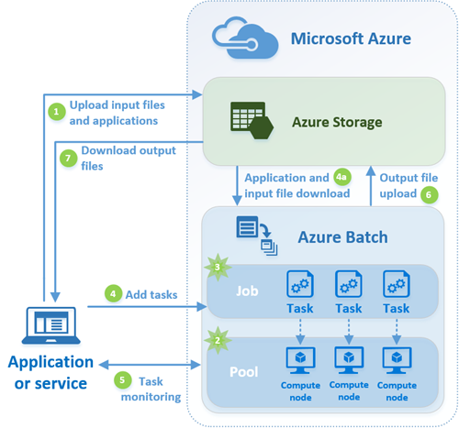

Batch Workflow
Notes:
Explain the workflow described as here: https://docs.microsoft.com/en-us/azure/batch/batch-technical-overview

Slide 51

Batch Shipyard
Batch Shipyard is an open-source utility that allows Batch users to use Docker containers as tasks on jobs instead of loading the jobs directly on the operating system for the compute nodes
“Docker containers wrap a piece of software in a complete filesystem that contains everything it needs to run: code, runtime, system tools, system libraries – anything you can install on a server. This guarantees that it will always run the same, regardless of the environment it is running in.”
Notes:
Batch Shipyard is a utility that allows Docker Containers to be used to run tasks instead of tasks being loaded directly onto the virtual machines in a pool. Docker by design allows all the software and software dependencies for an application to be housed in the container, and it is carried along with the container wherever it goes. Likewise, this allows containers to be scaled out massively. Once a container is built, it can be copied over and over. Likewise, the cleanup is easy. Once they are used, they can be discarded. This makes them ideal for running massive batch jobs.

Slide 52
What is Batch being used for?
Media Transcoding Media Services - audio and video transcoding, etc. TV Everywhere – video transcoding using ffmpeg XBox video – video pre-processing Rendering HoloLens team renders test environments using Blender Engineering companies rendering pipeline using 3DSMax and V-Ray on Linux VMs Test execution Azure Engineering CloudValidate service Intune runs 20K tests in 20 mins following check-in’s Financial risk analysis testing Risk analysis Towers Watson RAFM Other insurance ISV Banking & financial services company | Data ingestion and processing Azure StorSimple team ingest and pre-process to prepare for HDInsight jobs Nightly data ingestion and processing of automotive data ADF data copy activities Pricing models Energy pricing using python Monte Carlo quant models R and Spark models for hotels Engineering simulations Engineering ISV customers can run apps at scale Image processing Analyze MRI scans for sign of dementia Misc Tracking drug company spending against doctor prescriptions Aircraft route optimization and simulation
Notes:
Read out the different areas where the Batch service is being used. Explain few of them by giving an example so that everyone can grasp how the batch service actually helps in the real world scenarios.

Slide 53

Use Case – Azure Media Services
Azure Media Services:
Media transcoding platform service
Media-focused UI, API, pricing, SLA, etc.
Uses Batch for all transcodes
Supplies the transcoding applications
Hides the VM’s
Azure Media Services
Azure Batch
Azure Batch Usage:
Long-term pool of VM’s with transcoding applications installed
Pool scaled by Media Services according to load
Notes:
Here is the use case where Azure Media Services makes use of the Batch services for running the encoding jobs which require a lot of computing power and how Batch service provide the resource needed to run the high CPU intensive processing jobs without any problems.

Slide 54
Use Case – Software Test Service
Test Execution Service:
Engineers submit test suites for execution
Used for many Azure services
Azure Batch:
Pool of VM’s created for each test suite
Test suite is completely custom application
Pool auto-scaled according to queue size
Spread across multiple regions with multiple Batch accounts
Test Execution Service
Azure Batch
Notes:
A use case to show how Batch service helps in executing tests services in the cloud.

Slide 55

Use Case – Animated Feature Film Rendering
PROAN Entertainment – ‘Pepito – La Película’
90 minute 3D animated feature film
Would have taken over 13 years to render using existing on-premises cluster
Rendered entirely in Azure using Blender in about 3 months
Notes:
Rendering a high end 3D model or a movie or a scientific or computer simulation will hogs up a lot of computing power. Batch service let us do this intensive calculation and rendering in less time compared to a single machine.

Slide 56
Azure Batch - Cloud-enable applications
User Application or Service
Azure Batch
Cloud-enable applications, made available as SaaS:
Not producing a service
Higher-level set of capabilities
Minimizes required Azure knowledge
App Lifecycle, Data Movement,
User Management & Auth,
Quotas & Budget, Client Plug-in’s
VM Management & Job Scheduling
PaaS
Cloud Services
IaaS
Virtual Machines
Hardware
Notes:
Explain here on how to have a cloud enable applications with Azure Batch

Slide 57
Demo

Slide 58
Contact Us Technical services to help you win more deals, accelerate deployment and increase consumption
Microsoft Azure
http://aka.ms/PartnerTechnicalServicesAzure
Microsoft CRM Online
http://aka.ms/PartnerTechnicalServicesCRMOnline
Microsoft Office 365
http://aka.ms/PartnerTechnicalServicesO365
Microsoft Windows 10 and Enterprise Mobility Suite
http://aka.ms/PartnerTechnicalServicesWin10EMS
Learn more about your technical support benefits
http://aka.ms/MySupport

Slide 60
Schedule examples
To trigger once every five minutes:
"schedule": "0 */5 * * * *"
To trigger once at the top of every hour:
"schedule": "0 0 * * * *",
To trigger once every two hours:
"schedule": "0 0 */2 * * *",
To trigger once every hour from 9 AM to 5 PM:
"schedule": "0 0 9-17 * * *",
To trigger At 9:30 AM every day:
"schedule": "0 30 9 * * *",
To trigger At 9:30 AM every weekday:
"schedule": "0 30 9 * * 1-5",
Notes:
Here are some samples of CRON expressions you can use for the schedule property.

Slide 61
C# Libraries
Automatically imported
System
System
System.Collections.Generic
System.IO
System.Linq
System.Net.Http
System.Threading.Tasks
Microsoft.Azure.WebJobs
Microsoft.Azure.WebJobs.Host.
hosting environment defaults
mscorlib,
System
System.Core
System.Xml
System.Net.Http
Microsoft.Azure.WebJobs
Microsoft.Azure.WebJobs.Host
Microsoft.Azure.WebJobs.Extensions
System.Web.Http
System.Net.Http.Formatting.

Slide 62
C# Libraries
Hosting environment specials
System
Newtonsoft.Json
Microsoft.WindowsAzure.Storage
Microsoft.ServiceBus
Microsoft.AspNet.WebHooks.Receivers
Microsoft.AspNet.WebHooks.Common
Microsoft.Azure.NotificationHubs
Nuget Packages
To use NuGet packages in a C# function, upload a project.json file to the the function's folder in the function app's file system.

Slide 63
Scalability
High throughput with Service Bus
Trigger uses long polling
For immediate firing *minimum* polling interval should be 30 seconds
Throttled at 6000 actions/min
How to increase throughput
Use multiple Logic Apps sharing connection
Use multiple connections
Each Trigger can receive multiple messages in ‘batch’
Service Bus performance
1 connection & batch size of 1 => 6.5 msgs/sec
1 connection & batch size of 175 => 400 msgs/sec
10 connections & batch size of 175 => 1409 msgs/sec
Notes:
Logic Apps/connections: 1 Batch size: 1 Throughput: 6.5 msgs/sec
Logic Apps/connections: 1 Batch size: 175 Throughput: 400 msgs/sec
Logic Apps/connections: 10 Batch size: 175 Throughput: 1409 msgs/sec

Slide 64
B2B/EDI

Slide 65

XML Messaging and B2B
Integration Account
Includes Entity Metadata
EDI
XML & Flat file Processing
AS2 Encode and Decode
X12 Encode and Decode
XML Validation
XSLT Transformation
Convert flat files e.g. CSV to and from XML and convert between JSON and XML
EDIFACT Encode and Decode
Integration Account entity look up
Partner resolution
XPath support
Notes:
Integration Account, a container that stores the various artifacts you need for more complex business process workloads such as trading partner agreements.
Highlight Note: Integration Account makes it easier to reference the entities across workflows. For example: you can access parameters and values from a different workflow or created in your Integration Account configuration.
B2B, we are providing AS2, X12 EDI standards and EDIFACT. By enabling both encode and decode for these standards you are able to receive or send EDI documents from Logic Apps.
XML Processing Feature, in addition to language features such as xpath() you can now use our new XML processing actions to easily work with flatfile formats, transformation of documents using the industry standard XSLT (including BizTalk built-in Functoids support) and incorporate XML document validation into your Logic Apps control flow.

Slide 66
Tracking
Operations Management Suite
EDI and custom tracking
Integration
Account
Events emitted for sending & receiving as well as acknowledgement tracking
Turn on Azure Monitor
Push to storage, EventHub or Log Analytics
Tracking API for custom events
Solution Gallery
Tailored to B2B for easy management
Automatically associates data
Use TrackedProperties in your Logic Apps for custom data items
Rich schema for correlation
Create alerts for proactive monitoring
Download messages
"trackedProperties": {
"OrderNumber":
"@{
outputs('Compose')
['OrderLine']
['@OrderNumber']
}" }
Notes:
Integration Account, a container that stores the various artifacts you need for more complex business process workloads such as trading partner agreements.
Highlight Note: Integration Account makes it easier to reference the entities across workflows. For example: you can access parameters and values from a different workflow or created in your Integration Account configuration.
B2B, we are providing AS2, X12 EDI standards and EDIFACT. By enabling both encode and decode for these standards you are able to receive or send EDI documents from Logic Apps.
XML Processing Feature, in addition to language features such as xpath() you can now use our new XML processing actions to easily work with flatfile formats, transformation of documents using the industry standard XSLT (including BizTalk built-in Functoids support) and incorporate XML document validation into your Logic Apps control flow.

Slide 67
Demo: B2B Transformation

